Slide 1

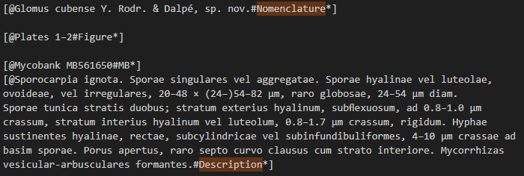
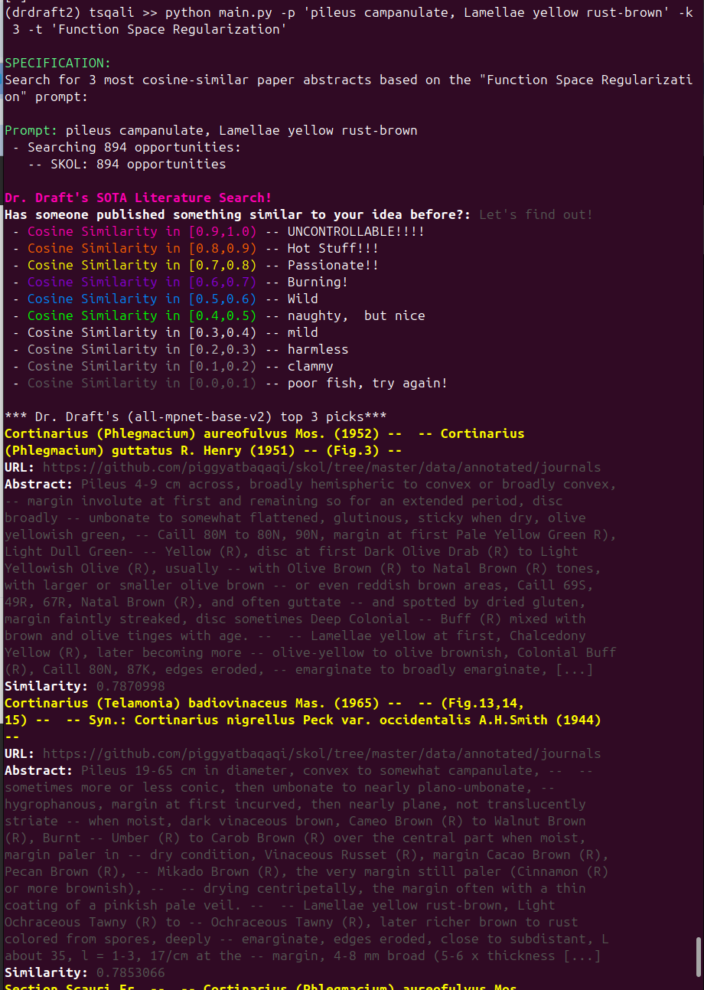
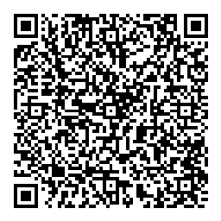
Synoptic Key of Life MASMC 2025
A work in progress
SKOL Part I
01
02
03
04
05
06
Parse
PySpark Automation
Classify
Remove
Extraneous
content
Generate
Taxon
* Embed
Taxon
Content
In Search
* Provide
Semantic
Search
Interface
SKOL Part II
May 2019: Manual annotation
Annotated 244 issues from old issues of 3 freely available journals:
  Persoonia, Mycotaxon, and Mycologia
  from mykoweb.com
Feb 2025 IST664 Language Embedding
Based on Dr. Draft’s SOTA LIterature Search from the Auton Lab.
Uses a Large Language Model (SBERT) to create a space of all nomenclature/description sets.
Provide a description on the command line which is embedded into the space.
Returns the closest matching descriptions by cosine similarity.
Should be publicly available at https://synoptickeyof.life by end of June 2025.
March 2025: IST718: pyspark Classification Pipeline
over 1000 unannotated documents to ingest
Parses OCR output into paragraphs
Classifies paragraphs into Nomenclature, Description, Misc-exposition.
Distributed pipeline to allow parallel processing.
June 2025: IST691: Feature Extraction for a Synoptic Key
Uses an LLM (gemma) to extract features and their values from each description
Annotate the resulting json with TF-IDF scores for every feature
Basis for building a synoptic key User Interface
Going forward: Productionization
Web bot to collect open content articles
Automated OCR pipeline
Provenance annotation
Front end
Resources
Collaborators:
JJ. Balasi
D. Caspers
C. Murphy
S. Osuga
L.H.P. Yarroll
coming soon: https://synoptickeyof.life
https://github.com/piggyatbaqaqi/skol
https://github.com/piggyatbaqaqi/dr-drafts-mycosearch
IST664 Synoptic Key of Life
IST718 Synoptic Key of Life II
https://github.com/autonlab/dr-drafts-sota-literature-search
This poster:
2025-09-25

